Slide 1
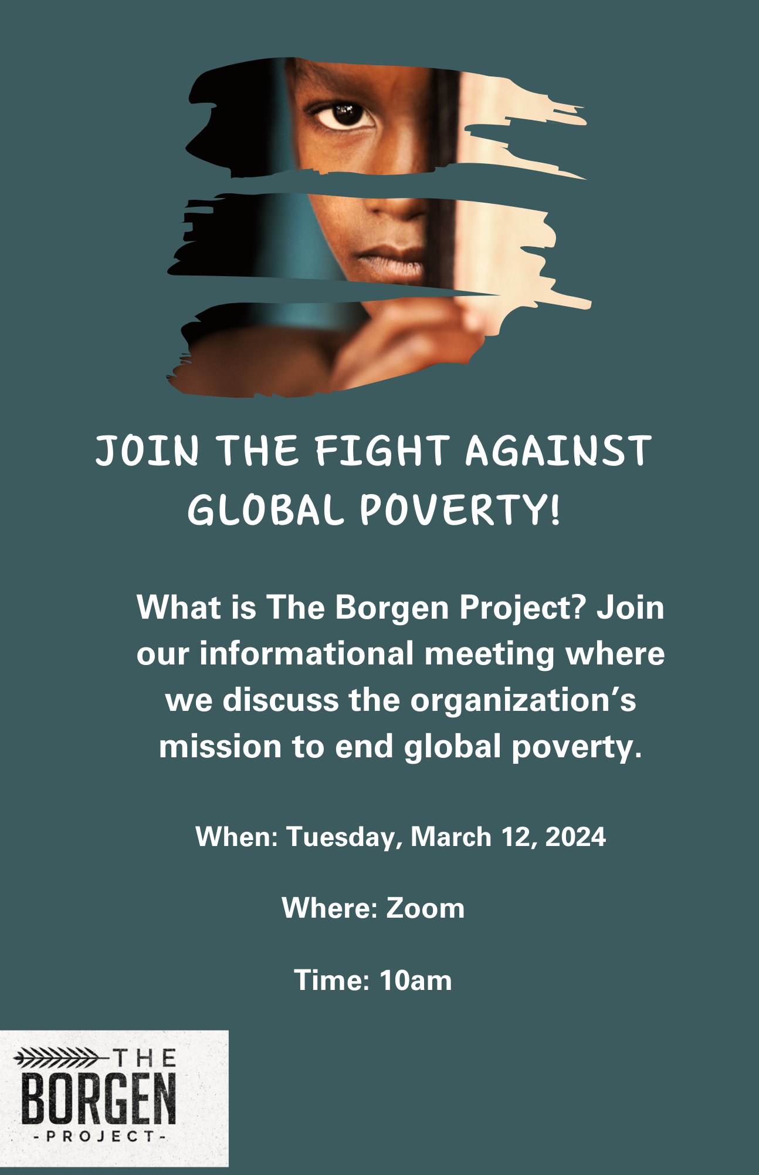
The Borgen Project
Join The Fight Against Global Poverty!

Slide 2


Slide 3
Objectives
Global Poverty Facts
What is The Borgen Project?
Why Global Poverty Matters
Ways To Get Involved

Slide 4
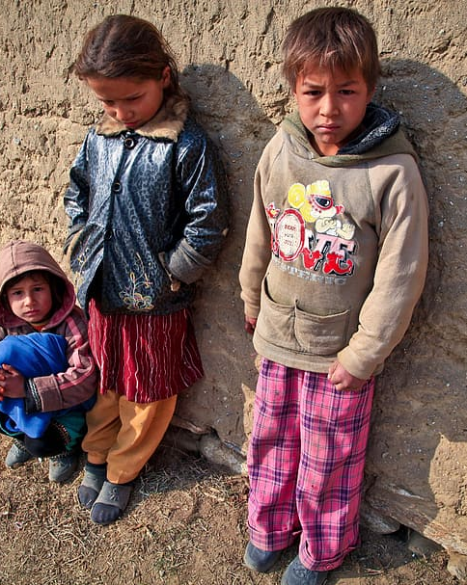
Global Poverty Facts
Studies show that 736 million people live in extreme poverty.
1 billion people don’t have electricity.
Over 2 million people lack access to healthy food.
About 2.5 million babies die after birth and 19.4 million babies lack immunity to diseases.
Only 1% of the US Federal Budget is spend on foreign aid.

Slide 5

What is The Borgen Project?
The Borgen Project is a nonprofit dedicated to downsizing global poverty through advocacy efforts including meeting with Congressional leaders, educating and mobilizing people around the world to join the fight against global poverty. So far, We’ve had two acts signed into law in 2022. The Global Food Reauthorization Act and The Global Malnutrition Prevention Act.

Slide 6
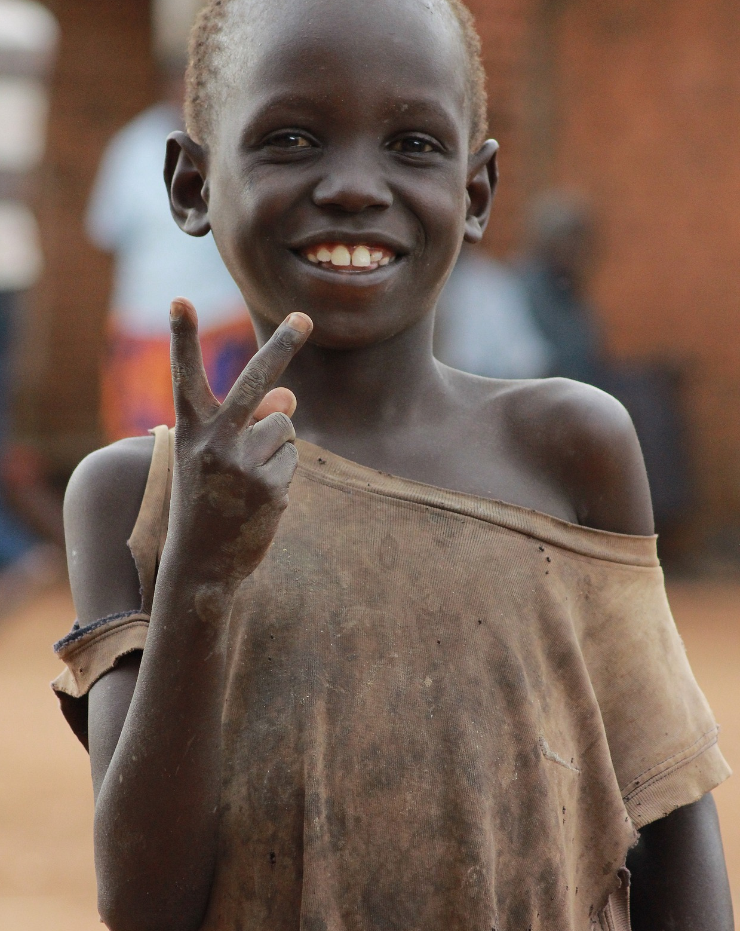
Why Should This Matter?
The United States as the most powerful nation in the world has the budget and the resources to prevent global poverty.
The military wants the US government to address global poverty.
Eradicating global poverty is good for the environment (prevents overpopulation and natural disasters) and national security (protects diplomacy efforts and protects the US from terrorist attacks.)

Slide 7
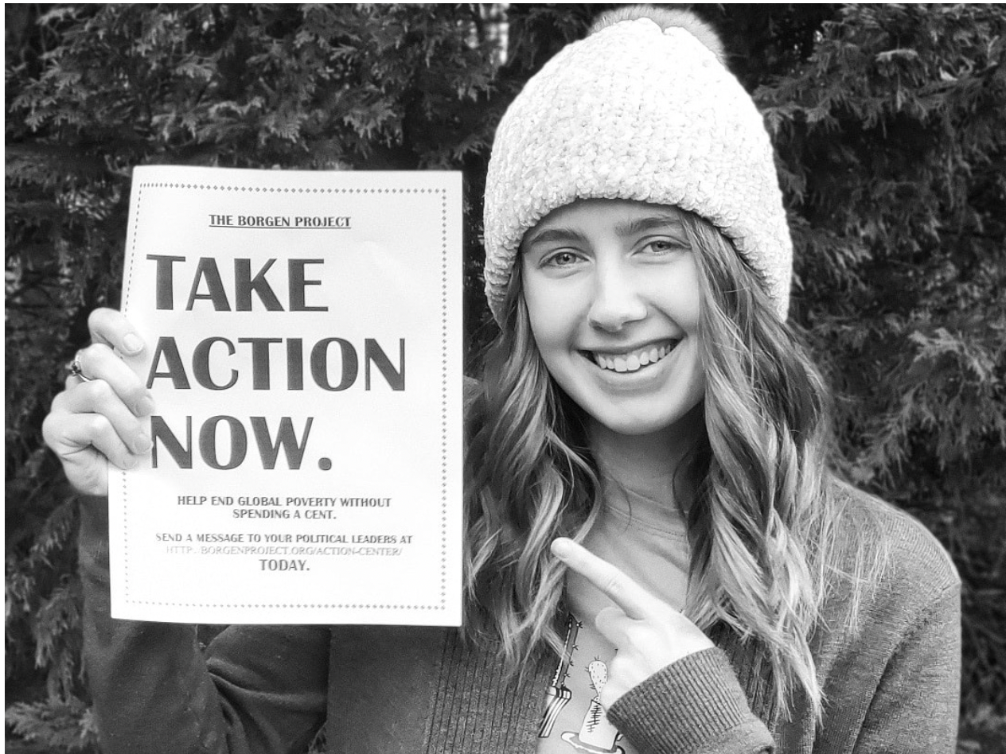
Get Involved
Call and email members of Congress
Spread awareness via social media.
Give speeches
Donate to borgenproject.org/donate

Slide 8
Get Involved
Internships
Volunteer Positions
Nonprofit Leadership
Political Affairs
Public Relations/Marketing
Writer/Journalist
Regional Director
Advocate
Writer
Guest Contributor
Note: All interns must contact congressional members and hold a fundraising campaign.

Slide 9
Learn More
borgenproject.org
facebook.com/borgenproject/
twitter.com/borgenproject
https://www.youtube.com/c/TheBorgenProject
instagram.com/theborgenproject

Slide 10
Thank You!
Any questions?

